Slide 1



Predicting Outlook of Stock Prices
By: Jamie Tran

Slide 2
Quick Facts on Investors:
Only 43% of people know what is in their workplace retirement accounts.
1
38% know all their investments in their non-retirement investment accounts.
2
44% of Americans choose stocks based on potential growth.
3

Slide 3



Business Problem:
Helping investment firms attract new business.
Creating sentiment analysis to help guide new and old investors.
Provides resources that help these firms stand out.

Slide 4

Data Elements:
Data collected from Yahoo Finance.
Contains 3 years' worth of stock price data for Google, Apple, and Tesla.
7 columns of all numerical data.

Slide 5
Data Preparation:
Check for missing values.
Split dataset by independent and dependent variables.
Created a training and test set from our new data frames.

Slide 6
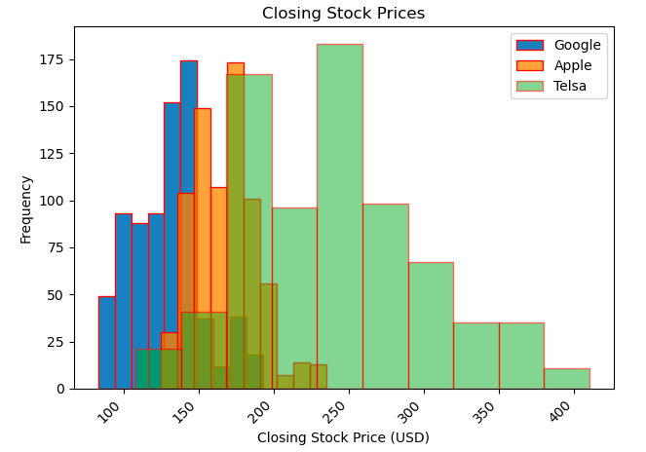
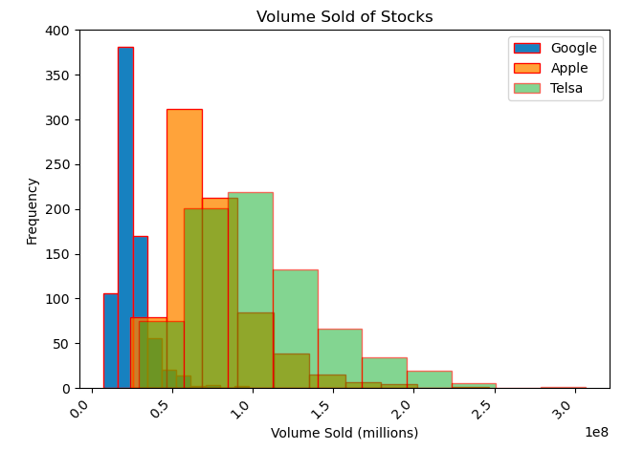
Method:
Exploratory data analysis.
Ridge Regression.

Slide 7

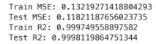
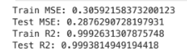
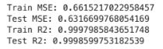
Results: Part One
Google results:
Apple results:
Tesla results:
Notes:
Mean squared error and r2 were used as our evaluation metrics for this research. I have the results for each stock listed below

Slide 8
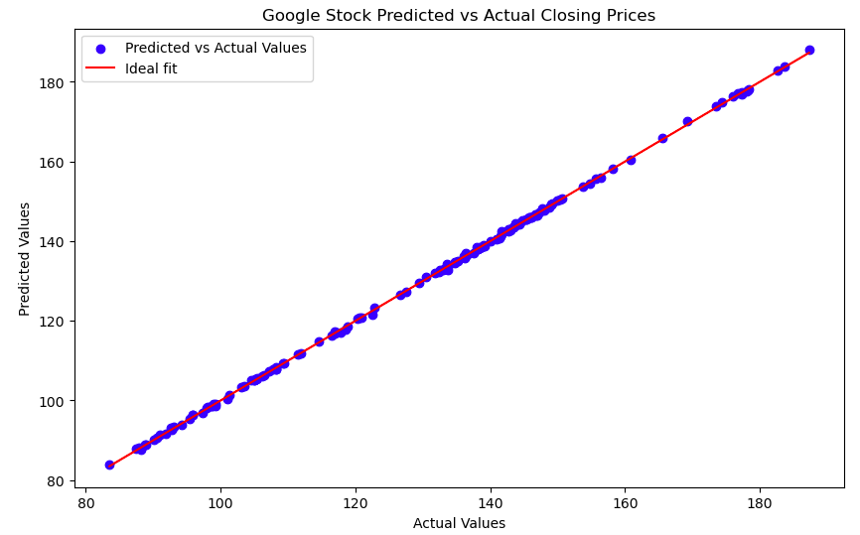
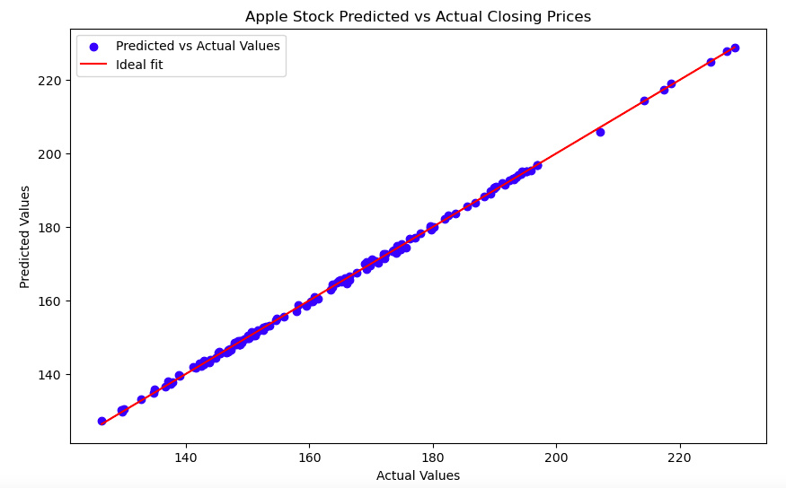
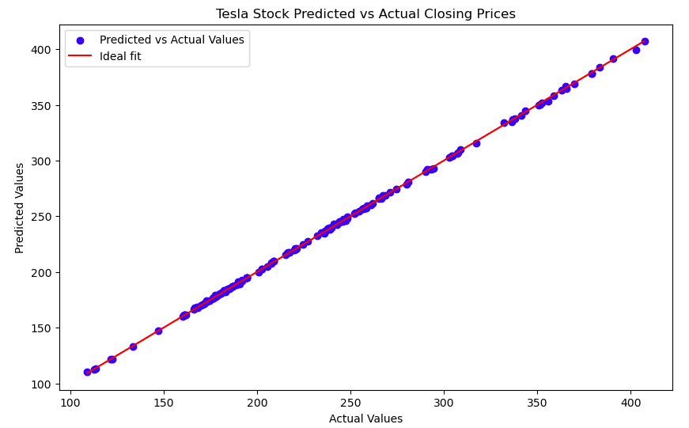
Results: Part Two
All stocks have a bullish outlook.

Slide 9
Conclusion:
We were able to build an accurate and reliable model.
Not suitable for highly volatile investments.
Mid-size stocks should be tested to ensure reliability.

Slide 10
References:
“Do You Know What Your Investments Are? Most Americans Don’t.” NerdWallet, www.nerdwallet.com/article/investing/do-you-know-what-your-investments-are-most-americans-dont#:~:text=Key%20findings,they%20hold%20in%20these%20accounts. Accessed 31 July 2024.
Alphabet Inc. (GOOG) Stock Historical Prices & Data - Yahoo Finance, finance.yahoo.com/quote/GOOG/history/. Accessed 31 July 2024.
Apple Inc. (AAPL) Stock Historical Prices & Data - Yahoo Finance, finance.yahoo.com/quote/AAPL/history/. Accessed 31 July 2024.
Tesla, Inc. (TSLA) Stock Historical Prices & Data - Yahoo Finance, finance.yahoo.com/quote/TSLA/history/. Accessed 31 July 2024.

